Slide 1
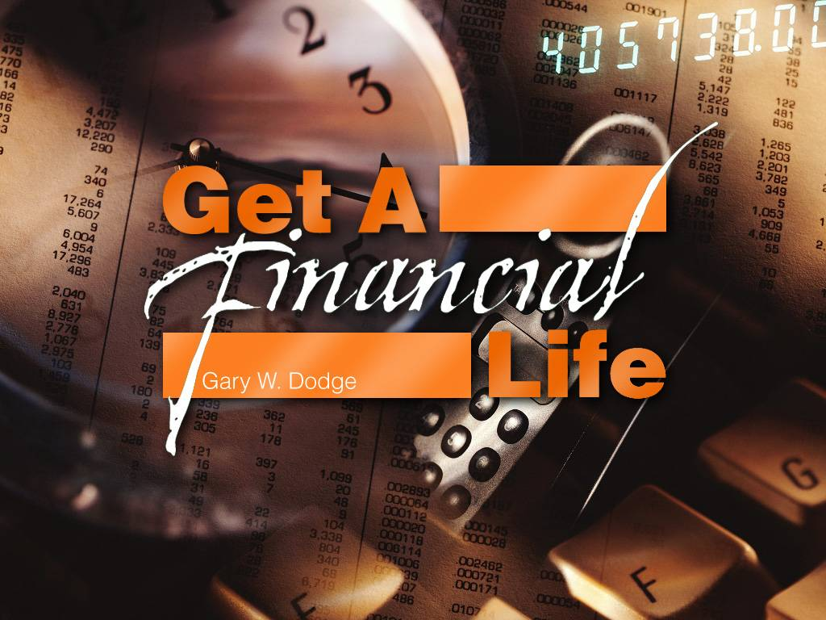
Сущность финансовой жизни

Slide 2

Консультативная встреча Евро-Азиатский Дивизион май 2011 г.
Жертвуя вы получаете
Служба Доверия
Евро - Азиатский Дивизион 2011

Slide 3
Почему планирование так важно?
Цель: Чтобы быть хорошими управителями, мы должны в молитве размышлять о том, что Бог вверил нам и как он хочет чтобы мы распоряжались этими благословениями.
Фактически: Нам часто не удается планировать и тогда мы оказываемся пленниками законов о наследстве оставленном без завещания, и не можем заботиться о тех, о ком мы раньше заботились.

Slide 4
Четыре основных инструмента планирования имущества
Завещание
Долговременная доверенность
Передача другому лицу прав по принятию важных медицинских решений в случае утраты дееспособности
Директивное письмо

Slide 5
Что может сделать завещание
Завещание – это законное заявление, влекущее определенные обязательства указывающее кто получит вашу собственность после вашей смерти.
В завещании указывается законный представитель, который исполнит ваши пожелания.
Завещание включает только ваше имущество официально утвержденное судом.

Slide 6
Завещатель – оставивший завещание
ВЫ определяете распределение
Вы назначаете опекуна
ВЫ назначаете исполнителя завещания
ВЫ можете создать трасты
Вы можете жертвовать на благотворительность
Notes:
TESTATE - WITH A WILL
There are many advantages for people who do have a will. First, you specify the distribution. You can give any amounts or percentages to the persons that you pick rather than depending on the state statute to allocate or distribute in a manner that you might find totally unacceptable.
Second, you nominate the guardian. If you have minor children, I'm sure you would far prefer to pick for yourself the most important person who will be entrusted with the care and upbringing of those loved ones, rather than have the state judge, who knows nothing about you or your family or your desires, select someone to be the guardian.
Third, you choose the executor, a personal representative. He or she has a great deal of power and authority. He or she will be in charge of managing the estate, paying all the bills, and making the final distributions under your plan. You want to make sure you have selected someone who will do a good job and see that the plan is properly carried out.
Fourth, you can create trusts. There are many reasons to create trusts. Some family members would be far better to receive distributions of income rather than a lump sum principal amount. You can make provisions for these family members in a way that is most helpful to them in a trust.
Finally, you can make transfers to charity. The gifts to charity could serve as a legacy or remembrance to your involvement and support of those charities during your lifetime.

Slide 7
Почему мы не составляем завещания
Очень заняты
Очень мало имущества
Слишком дорого
Не нравятся юридические документы
Неизвестность будущего
Не планирую умирать
Notes:
REASONS WE DON'T MAKE WILLS
If we were to visit with people that don't have wills, perhaps we would hear these statements. Person number 1 is too busy with life. He has many irons in the fire. As he goes from work, to home, to meeting, he just doesn't have time to get one done.
Person number 2 says they have too little property. They aren't worth large amounts of money and they don't feel they need a will with their amounts of property. Of course, what they perceive as too little property may actually turn out to be quite a bit of value by the time they pass away. There are a number of cases of people who had fairly modest means or investments, but during their latter years their investments significantly increased in value and they passed away with no will and large property.
Person number 3 thinks it's too expensive. While it is true that a will can cost $200, $300 even $500 or more, the expense of the will must be compared with the expense of not having a will. There are a number of people who did not have wills and their estates went into probate. By the time the cousins and relatives and attorneys and everyone else fought over the estate for several years, the will that they eventually ended up with by court decree cost them $10's of thousands and even millions of dollars.
Number 4 - They don't like legal documents. I can understand people not liking legal documents. They're sometimes hard to read and sort out. I encourage people to see that their lawyer gives them a good explanation or, in some cases, a short summary of what it is that this document does for them. You need to be sure that you understand the legal documents that are going to make substantial provision for all of your family and friends.
Number 5 - Person number 5 says they're unable to know the future. Well, I do have one bit of news for person number 5. In this country several millions of people who don't know the future have faced one certainty and that was that they would die and pass away. When they died they left their property behind. Some left property behind in good situations; some left property behind and created colossal problems for their family and friends.
I don't plan to die. Person number 6 simply plans to go on and on. He takes his vitamins, gets that morning walk, and has that post card in his drawer addressed to Willard Scott for his 100th birthday. He just plans to keep on going.
Well, folks, at some point this is something that is going to happen to all of us. In the history of the world, it has been noted with regularity that people do pass away. The fact that you do or don't have a will doesn't seem to have much of an impact on whether you do pass away. If anything, the indications are that those who have good plans have greater peace of mind and, if anything, live longer.

Slide 8
Долгосрочная доверенность
Позволяет вам назначить человека, который будет заниматься вашими финансовыми делами.
Может вступить в силу незамедлительно.
Может вступить в силу только тогда, когда вы будете нетрудоспособны.
Может назначить кого-то, кто будет для вас в качестве доверительного управляющего или опекуна.
Все доверенности истекают с момента вашей смерти.

Slide 9
Медицинские директивы
Медицинские директивы могут быть
Доверенность по охране здоровья
Передача другому лицу прав по принятию важных медицинских решений в случае утраты дееспособности
Доверенность на медицинский уход
Завещание на случай смерти
Убедитесь в том, что ваши документы действительны!

Slide 10
Директивное письмо
Директивные письма не являются заменой завещания.
Вы можете оставить простое директивное письмо оставшимся в живых родственникам в отношении финансовых и личных вопросов.
Выделите некоторое время, чтобы дать определенные указания вашей семье и друзьям чтобы снизить стресс в трудное время.

Slide 11
Специализированный инструмент - Трасты
Траст – это договор, в котором «доверительный собственник» является законным собственником имущества другого человека.
Доверительный собственник получает определенные указания в отношении распоряжения активами после смерти учредителя доверительной собственности.
При необходимости доверительный собственник может взять на себя управление активами до смерти доверителя.

Slide 12
Преимущества трастов
Договоры об учреждении траста конфиденциальны.
При оформлении трастов нет необходимости в официальном утверждении судом. Все средства, которые хранились в трастах перед смертью доступны для последних затрат и распределения.
Некоторые трасты помогают позаботиться
об «особых нуждах» членов семьи
и друзей.

Slide 13
Недостатки трастов
  Цена
  Рост функций управления при жизни

Slide 14
Часто задаваемые вопросы
Когда мне нужно начинать думать о планировании имущества?
Где нужно хранить документы?
Кто может мне помочь начать это?

Slide 15
Периоды жизни
Создание Накопление Хранение Распределение
Notes:
LIFE CYCLES
Each of us goes through 4 different cycles during our lifetime. The first is symbolized by a light bulb and that is creation of ideas and the means to acquire property. This creation period typically includes our time in formal education, during which we are acquiring skills which will serve us well during the later stages of life.
Second, there is a period of accumulation where we spend the majority of our life applying all those skills and energies building the estate. If we are fortunate and skillful in that building process, there will be a significant estate as we approach our retirement age.
Third, there is a time of conservation indicated by the green tree. During our retirement years, we are less likely to focus on the building or increasing of the estate, but perhaps have more concern with conserving the estate and preserving it for those retirement years.
Finally, the time will come for distribution. When Mr. Rockefeller's accountant was asked how much he left, the accountant replied, "Well, he left it all." At some point there must be a distribution of this property to the beneficiaries that have been carefully selected by the owner.

Slide 16
Мирской подход
Только два места
Семья Государство
Notes:
ESTATE DISTRIBUTION
In considering where you want your estate to be distributed, please remember that the estate can be distributed outright to family, to charity or to the government. Of course, it is always permissible to make voluntary contributions to the government during life or at death, and these do qualify for the charitable deduction. However, for many people with larger estates, the government may turn out to be their favorite charity. If they do not plan properly, the government may take as much as half of their entire estate, and the balance may then be distributed to the people that they select. However, with good planning, one can frequently maximize the distributions to family and to charity and minimize the amount taken by the government.

Slide 17
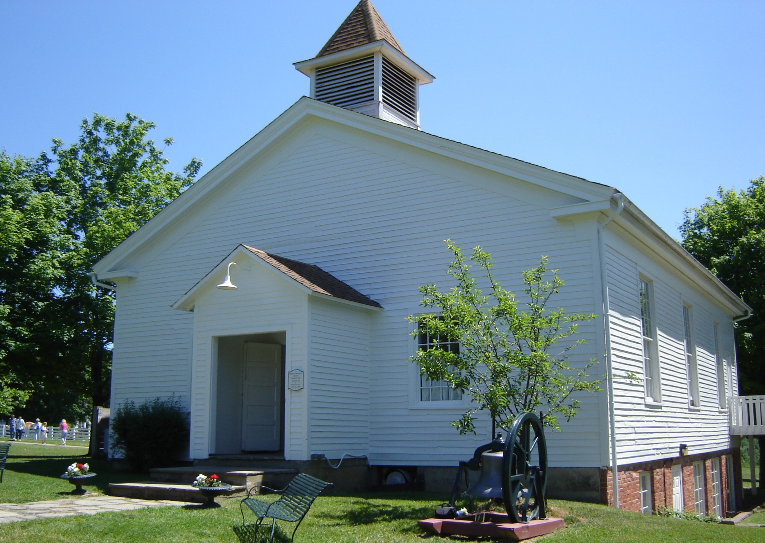
Возможности благотворительности

Slide 18
Распределение имущества
Только три места
Семья Благотворительность Государство
Notes:
ESTATE DISTRIBUTION
In considering where you want your estate to be distributed, please remember that the estate can be distributed outright to family, to charity or to the government. Of course, it is always permissible to make voluntary contributions to the government during life or at death, and these do qualify for the charitable deduction. However, for many people with larger estates, the government may turn out to be their favorite charity. If they do not plan properly, the government may take as much as half of their entire estate, and the balance may then be distributed to the people that they select. However, with good planning, one can frequently maximize the distributions to family and to charity and minimize the amount taken by the government.

Slide 19
Что такое траст?
Учредитель доверительной собственности
Попечитель
Доверитель
Получатель
Сроки
Notes:
WHAT IS A TRUST?
Perhaps most of you at this meeting here today have never had a trust. It is important that we all understand what a trust is and how it works. One of the keys to understanding trusts is to know the meanings of a few basic terms.
First, there must be a trustor. This is the person that sets up the trust. He or she transfers property to the trustee and sets up the basic rules for distribution of the income and principal from that trust.
The trustee receives property and a written trust document. The document tells the trustee who should receive the income from the property and how long the trust will last and who will finally receive the corpus or principal. The principal is the property held in the trust. A basic and important definition is the difference between income and principal. Income is the dividends or interest or other types of payments that are earned by investing the trust principal. The principal includes the underlying assets which may include land, stocks, bonds or other types of property.
Beneficiaries under the trust instrument come in two general categories. First, there are the income beneficiaries, those persons or organizations which will receive the income payments. Second, there are the principal beneficiaries, sometimes called the remaindermen because they receive the principal only after all the income payments have been made.
Finally, there are terms of the trust. A trust may last for many years and the trustor must tell the person drafting the trust what these terms should be. Simple terms might be paying out a certain percentage to one party or to other parties, an ability to make distributions of trust principal at certain times and under certain conditions and the final distribution of trust principal to the remainderman.

Slide 20
Для чего мне нужно давать планируемые пожертвования?
Многие люди хотят давать пожертвования на благотворительные цели, но они должны поступить таким образом, чтобы удовлетворить их личные и финансовые потребности, а также нужды семьи.
Планируемые пожертвования являются альтернативой пожертвований на благотворительные цели, что позволит вам:
Принести больше пожертвований на благотворительные цели, чем вы считали возможным.
Notes:
20

Slide 21
Почему я должен давать планируемые пожертвования?
Создать поток доходов при жизни
Планирование финансовых нужд супруга(и) или родных
Передача имущества и накоплений наследникам меньшей суммы
Уменьшит подоходный налог и/или отсрочить уплату налога по приросту капитала
План передачи вашего бизнеса
Оставить благотворительное наследство для будущих поколений
Notes:
21

Slide 22
Траст «двойных пожертвований»
Имущество
$200,000
Траст
$200,000
Благотворительность
$200,000 (After income)
Выплата инвестиционного дохода
Семья
(Сумма: $200,000)
Notes:
"GIVE IT TWICE" TRUST
In this illustration, a family with a medium-sized estate decides to benefit both the family and charity. After mother and father pass away the $500,000 estate is transferred into a trust. This trust pays income to family members until a total of $500,000 has been distributed as income. Typically, this will take from twelve to fifteen years. After the $500,000 has been given as income to family, the principal is then distributed to the charity. While the family will have to pay tax on the income, it is an excellent way for parents to remember family for a period of years and distribute the balance of their estate to a charity.

Slide 23
Благотворительность включает в себя:
    Личные цели дарителя
    Цели семьи дарителя
    Благотворительные цели дарителя
    Планирование пожертвований на благотворительные цели
Использует множество документов и стратегий
Включает советника и благотворительность дарителя
  Может обеспечить поток прижизненного дохода
  Может включать отсроченное дарение
  Может включать настоящие дары
  Может включать разнообразные активы
Notes:
23

Slide 24
Что такое
ежегодная выплата пожертвований
на благотворительные цели?
Договор
Получатель ежегодной ренты
Благотворительность
Получатель
Зависимый от сроков
Фиксированные платежи
Notes:
WHAT IS A TRUST?
Perhaps most of you at this meeting here today have never had a trust. It is important that we all understand what a trust is and how it works. One of the keys to understanding trusts is to know the meanings of a few basic terms.
First, there must be a trustor. This is the person that sets up the trust. He or she transfers property to the trustee and sets up the basic rules for distribution of the income and principal from that trust.
The trustee receives property and a written trust document. The document tells the trustee who should receive the income from the property and how long the trust will last and who will finally receive the corpus or principal. The principal is the property held in the trust. A basic and important definition is the difference between income and principal. Income is the dividends or interest or other types of payments that are earned by investing the trust principal. The principal includes the underlying assets which may include land, stocks, bonds or other types of property.
Beneficiaries under the trust instrument come in two general categories. First, there are the income beneficiaries, those persons or organizations which will receive the income payments. Second, there are the principal beneficiaries, sometimes called the remaindermen because they receive the principal only after all the income payments have been made.
Finally, there are terms of the trust. A trust may last for many years and the trustor must tell the person drafting the trust what these terms should be. Simple terms might be paying out a certain percentage to one party or to other parties, an ability to make distributions of trust principal at certain times and under certain conditions and the final distribution of trust principal to the remainderman.

Slide 25
Ежегодная рента с пожертвованиями на благотворительные цели
Активы
Ежегодная выплата
Две жизни
Благотворительность
1 или 2 пожизненных дохода
Ставка с дохода с благотворительными вычетами в зависимости от возраста
Преимущество благотворительности
Notes:
CHARITABLE TRUST
There are several different forms of charitable trusts. One of the most popular is a trust that has attractive tax benefits, pays income to family for a period of time and then passes as a remainder to charity. This illustration shows property being transferred into such a charitable trust.
The primary benefits are the ability to sell tax free and bypass capital gains and also receive a generous income tax deduction. After the property is sold and reinvested the two donors in this case receive income for their lives. They are able to receive a significantly increased income over prior income. Best of all, the full value of the trust, with no decrease due to payment of capital gains tax, is earning income for their joint life times. This income might be stable or could have a feature that allows it to increase each year.
After the substantial income payments have been made for two lives, the principal is then eventually distributed to charity. The reason this trust is permitted to have the generous tax benefits is that the remainder will eventually be distributed to the charity selected by the trust creators.

Slide 26
Ежегодная рента с пожертвованиями на благотворительные цели
$ Активы
Ежегодная выплата
$75,000
Ставка дохода с благотворительными вычетами в зависимости от возраста – 6.45%
Отсроченный прирост капитала - сбережения $11,250
Благотворительность $$$$
Две жизни
$4,837 Ежегодно
Преимущества благотворительности
Вычет подоходного налога $18,609 сумма, сэкономленная за счет уменьшения налоговых платежей $4,652
Notes:
CHARITABLE TRUST
There are several different forms of charitable trusts. One of the most popular is a trust that has attractive tax benefits, pays income to family for a period of time and then passes as a remainder to charity. This illustration shows property being transferred into such a charitable trust.
The primary benefits are the ability to sell tax free and bypass capital gains and also receive a generous income tax deduction. After the property is sold and reinvested the two donors in this case receive income for their lives. They are able to receive a significantly increased income over prior income. Best of all, the full value of the trust, with no decrease due to payment of capital gains tax, is earning income for their joint life times. This income might be stable or could have a feature that allows it to increase each year.
After the substantial income payments have been made for two lives, the principal is then eventually distributed to charity. The reason this trust is permitted to have the generous tax benefits is that the remainder will eventually be distributed to the charity selected by the trust creators.

Slide 27
ЕЖЕГОДНАЯ РЕНТА
ОТСРОЧЕНЫХ ДАРОВ
Прямой налоговый вычет
Фиксированная оплата на будущее
После смерти дарителя дар переходит на благотворительность

Slide 28

ПРИМЕР ЕЖЕГОДНОЙ РЕНТЫ ОТСРОЧЕНЫХ ДАРОВ
Вам и вашему(й) супругу(е) 50 лет а к 65 годам вы бы хотели дополнить свой доход, а также после смерти сделать пожертвование на благотворительные цели.
Ваш дар $50,000 ежегодной ренте отсроченных даров. Получаете $8,157 благотворительных вычетов.
Получаете ежегодно на жизнь $3,940 (41.8% не облагаемые налогом) – 7.88%
В момент смерти баланс ежегодной ренты переходит на благотворительность согласно вашему выбору.

Slide 29

ЕЖЕГОДНАЯ РЕНТА ПОЖЕРТВОВАНИЙ НА БЛАГОТВОРИТЕЛЬНЫЕ ЦЕЛИ
Прямой налоговый вычет
Срочный платеж
После смерти дарителя дар передается на благотворительность

Slide 30
ПРИМЕР ЕЖЕГОДНОЙ РЕНТЫ
Вам 67 лет и вы бы хотели дополнить ваш доход, а также после смерти сделать пожертвование на благотворительные цели.
Ваш дар ежегодной ренте отсроченных даров $20,000. Вы получаете $7,199 благотворительных вычетов.
Вы получаете ежегодно на жизнь $1,080 (5.4%) и $700 не облагаемых налогом.
В момент смерти баланс ежегодной ренты переходит на благотворительность согласно вашему выбору.

Slide 31
Ежегодная рента отсроченных даров на образование
Прямые налоговые вычеты
Может выплачиваться на протяжении многих лет
После многолетнего срока остаток переходит на благотворительность

Slide 32
ПРИМЕР ЕЖЕГОДНОЙ РЕНТЫ
ОТСРОЧЕНЫХ ДАРОВ
Внучке 2 года. Вам нужно оплатить за четыре года обучения в академии.
Дар $30,000 ежегодной ренте отсроченных даров, получаете $6,274 удержания налога.
В возрасте 15 лет внучка ежегодно получает $9,853 не протяжении четырех лет.
В конце четырех лет баланс на благотворительность выбираете вы.

Slide 33
Не замечательно ли несмотря на то, что с вами произойдет, знать что вы уже приготовили подарок для ваших детей или внуков и средства для благотворительности?

Slide 34
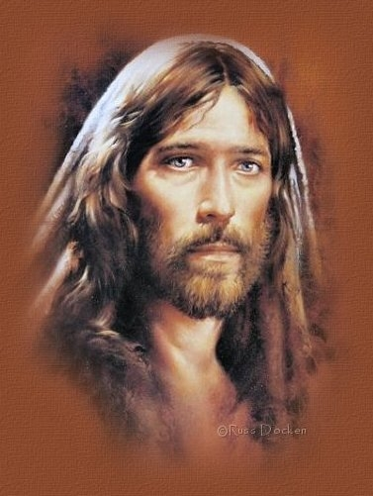
Божья программа планируемых пожертвований
“Пожертвования - это не Божий метод зарабатывать деньги; это возможность собрать людей у ног Его Сына»

Slide 35
Те, кому нравится все что у них есть,- счастливее, чем те, которые пытаются иметь все, что им нравится.

Slide 36
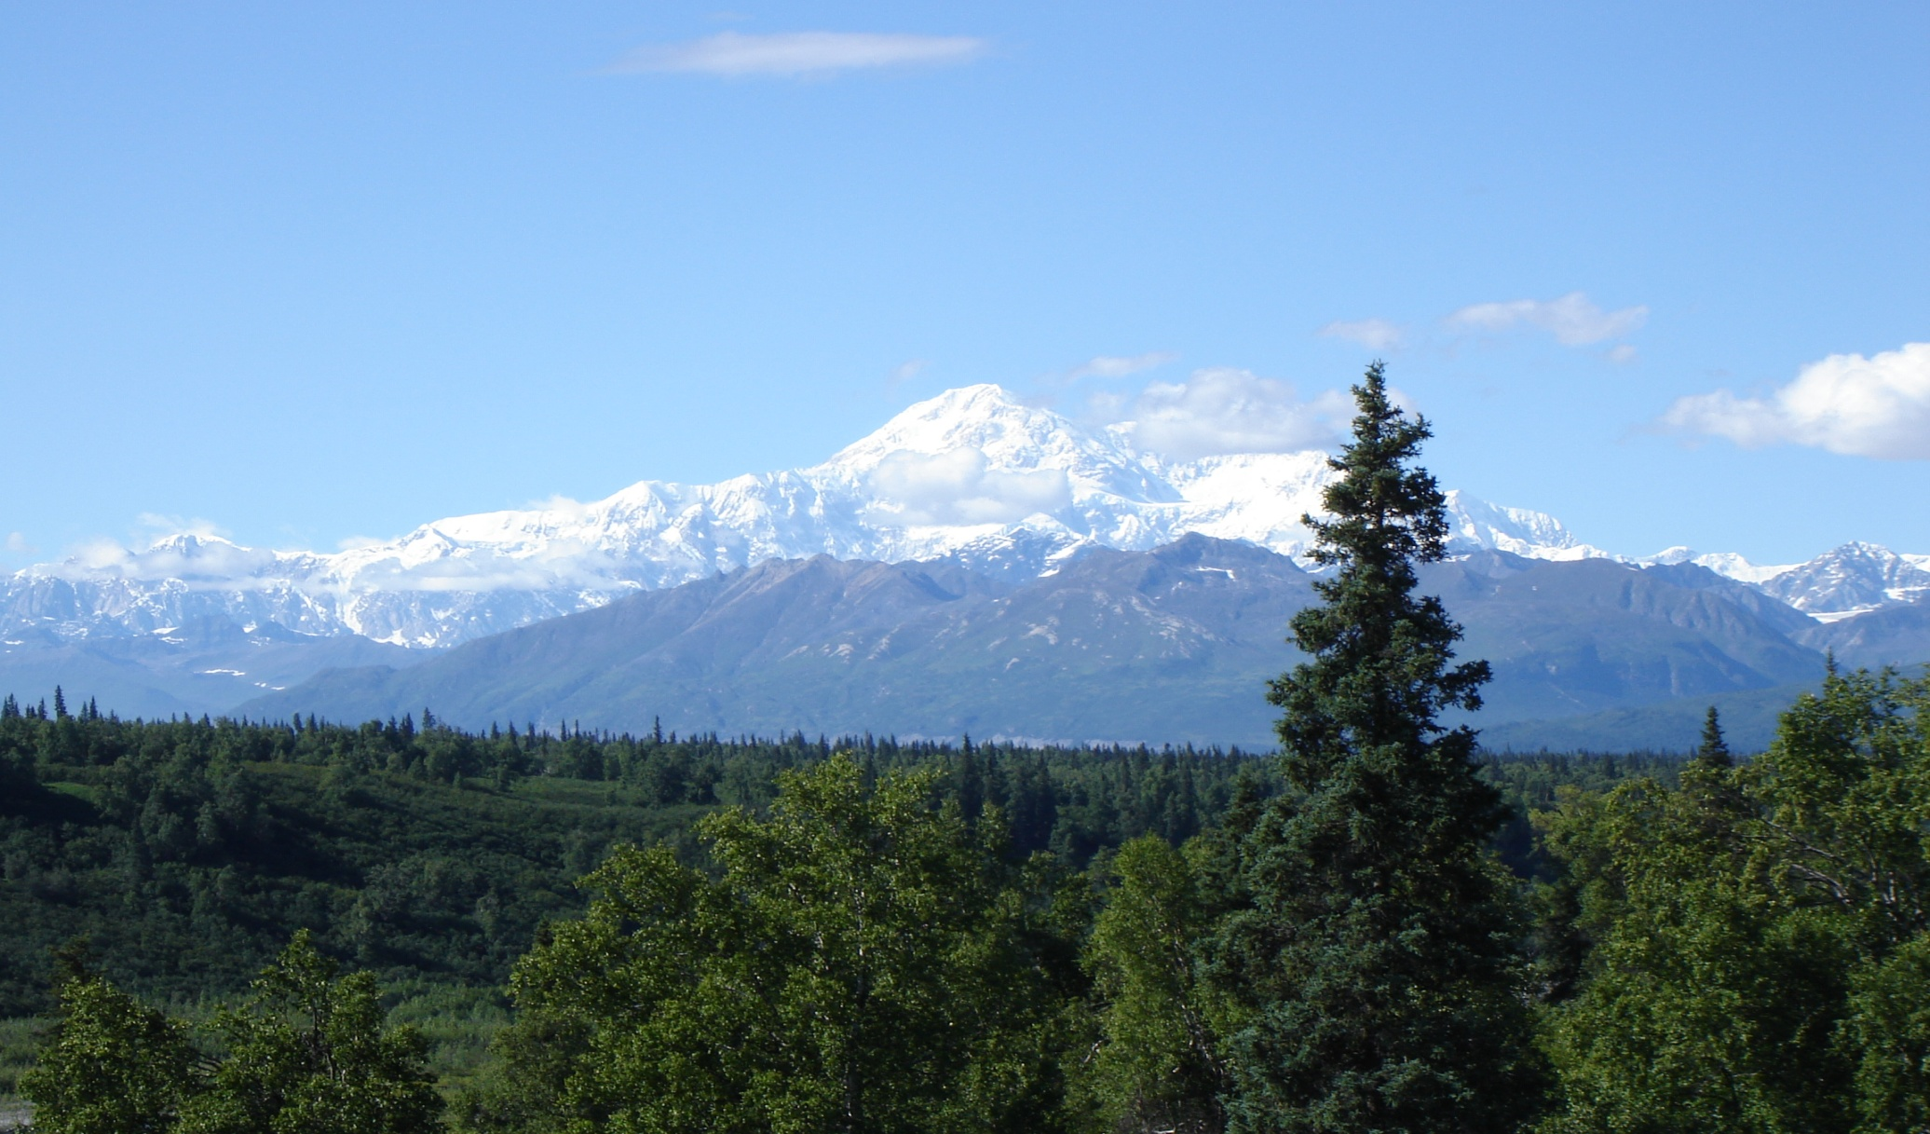
Вопросы

