Slide 1
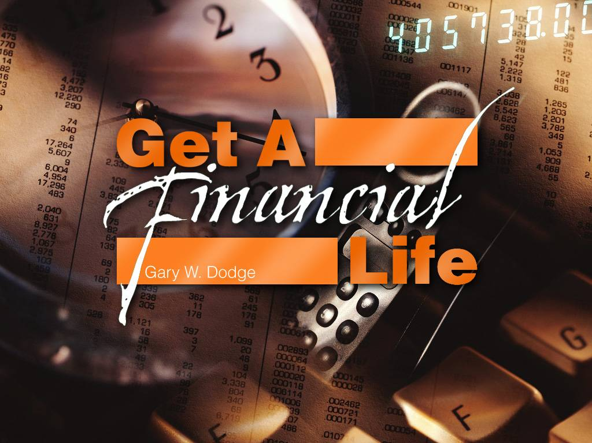
Сущность финансовой жизни

Slide 2
ПОТЕНЦИАЛ ПОЖЕРТВОВАНИЙ НА БЛАГОТВОРИТЕЛЬНЫЕ ЦЕЛИ:
ПОЖЕРТВОВАНИЯ В США в 2009 Г.
Фонды
$38.44 13%
Корпорации
$14.10 4%
Физ. лица
$227.41 75%
Завещания
$23.80 8%
Физ. Лица
Завещания
Фонды
Корпорации
Итого: $303.75 биллион
Notes:
2

Slide 3
11 вещей, которые нужно запомнить
Исследование Планируемых пожертвований… Руководство планирования пожертвований на благотворительные цели…
Преимущества и возможности
Май 2011 г.
Евро азиатский Дивизион
Гарри В. Додж
Директор Службы Доверия
Генеральная Конференция Адвентистов Седьмого дня

Slide 4
В Библии есть немало упоминаний о деньгах
Молитва - 500 текстов
Вера - 500 текстов
и !!! 2,350 текстов - как управлять деньгами и имуществом
Наше отношение к деньгам влияет на наши взаимоотношения с Богом – Лк.16:11

Slide 5
Управление ресурсами
Основа истинной религии
«Господь составил план спасения таким образом, что он начинается и заканчивается благотворительностью»
(Свид.для Ц.3том 548стр.ориг.)
Начинается:
«Ибо так возлюбил Бог мир, что отдал …» Ин. 3:16
И заканчивается:
«Соберите ко Мне святых Моих, вступивших в завет со Мною при жертве».
(Пс 49:5)

Slide 6
Это ваше, мое и наше?
Имущество конкурирует с Господом за право управления нашей жизнью – Мтф. 6:24
Собственность? Втор.10:14 и Пс. 23:1
Когда мы признаем нашу принадлежность Богу, все финансовые решения становятся духовными решениями!

Slide 7
Божья программа
Службы Доверия
«Пожертвования – это не Божий метод
зарабатывать деньги; это метод
собрать людей перед Величие Его Сына»
1. Лев. 27:30 – «И всякая десятина…»
2. Мтф. 6:19-21- «Не собирайте себе сокровищ на земле…»
3. Мтф. 6:24,25 – «Никто не может служить двум господам…»
2 Коринфянам 9:6-11 – «Кто сеет скупо, тот скупо и пожнет…»

Slide 8
УПРАВЛЕНИЕ РЕСУРСАМИ -
ОСНОВА ИСТИННОЙ РЕЛИГИИ
1969 г., автор м.Е. Рис
«Очень странно, что несмотря на то, что управление ресурсами является основой религии, о нем говорится меньше всего и это самая трудно понимаемая доктрина для всех христиан. И все же, управление ресурсами является неотъемлемой частью плана спасения».

Slide 9
ПЕРИОДЫ ЖИЗНИ
Создание Накопление Хранение Распределение
Notes:
LIFE CYCLES
Each of us goes through 4 different cycles during our lifetime. The first is symbolized by a light bulb and that is creation of ideas and the means to acquire property. This creation period typically includes our time in formal education, during which we are acquiring skills which will serve us well during the later stages of life.
Second, there is a period of accumulation where we spend the majority of our life applying all those skills and energies building the estate. If we are fortunate and skillful in that building process, there will be a significant estate as we approach our retirement age.
Third, there is a time of conservation indicated by the green tree. During our retirement years, we are less likely to focus on the building or increasing of the estate, but perhaps have more concern with conserving the estate and preserving it for those retirement years.
Finally, the time will come for distribution. When Mr. Rockefeller's accountant was asked how much he left, the accountant replied, "Well, he left it all." At some point there must be a distribution of this property to the beneficiaries that have been carefully selected by the owner.

Slide 10
ПОЧЕМУ Я ДОЛЖЕН ОДАВАТЬ ПЛАНИРУЕМЫЕ ПОЖЕРТВОВАНИЯ?
1.ОНИ ПОМОГАЮТ ВАМ ДАТЬ БОЛЬШЕ ПОЖЕРТВОВАНИЙ НА БЛАГОТВОРИТЕЛЬНЫЕ ЦЕЛИ, ЧЕМ ВАМ КАЗАЛОСЬ ВОЗМОЖНЫМ.
2.Это УВЕЛИЧИВАЕТ ВАШ ТЕКУЩИЙ ПОТОК ДОХОДА
3. Они ПОМОГАЮТ СПЛАНИРОВАТЬ НУЖДЫ СУПРУГА(и) ИЛИ РОДНЫХ
4.ПОМОГАюет ОБЕСПЕЧИТЬ НАСЛЕДСТВО ДЛЯ ВАШИХ НАСЛЕДНИКОВ ПО СНИЖЕННЫМ НАЛОГАМ.
5. РАЗНООБРАЗит ИНВЕСТИЦИОННЫЙ ПОРТФЕЛЬ
6.Содействет ПОЛУЧению ДОХОДа ОТ ВАШЕГО СОБСТВЕННОГО ЖИЛЬЯ
7. Поможет ПЛАНИРОВАТЬ ПЕРЕДАЧУ ВАШЕГО БИЗНЕСА
8. Мотивирует ПЕРЕДАТЬ НАСЛЕДСТВО НА БЛАГОТВОРИТЕЛЬНОСТЬ БУДУЩИМ ПОКОЛЕНИЯМ

Slide 11
РАСПРЕДЕЛЕНИЕ ИМУЩЕСТВА
Только три места
Семья Благотворительность Государство
Notes:
ESTATE DISTRIBUTION
In considering where you want your estate to be distributed, please remember that the estate can be distributed outright to family, to charity or to the government. Of course, it is always permissible to make voluntary contributions to the government during life or at death, and these do qualify for the charitable deduction. However, for many people with larger estates, the government may turn out to be their favorite charity. If they do not plan properly, the government may take as much as half of their entire estate, and the balance may then be distributed to the people that they select. However, with good planning, one can frequently maximize the distributions to family and to charity and minimize the amount taken by the government.

Slide 12
Чтобы сделать безвозвратный дар
Чтобы получить гарантированный поток доходов при жизни
Чтобы получить снижение налогов и часть страховой выплаты свободной от налогов
Чтобы помнить о любимой благотворительности
Самые ЛУЧШИЕ основания….
Для чего нужна ежегодная рента даров?
Notes:
WHY HAVE A WILL?
There are several reasons to create a will. You may not be able to accomplish a number of your personal objectives if you do not have a will. For example, with a will you can choose your own executor or personal representative. I know that each of you would prefer to have someone you know and trust handle your personal affairs rather than some individual appointed by the court who may administer a hundred estates and yours is simply one of that group.
Second, you can nominate a guardian for any minor children or dependents. This is a very personal decision and is an essential reason for all parents of young children to have wills.
Third, you're able to remember persons who would not benefit otherwise. If you have no will, then the state statutes which vary from state to state (many people die in a state other than in the state where they are currently residing) will decide who receives the property and how much they receive. You may have a friend or distant relative whom you would like to benefit who will receive nothing under the statutes of the state in which you would die.
Finally, charities will receive nothing if they are not remembered in a will. I know of a case in which a friend was a supporter of a charity all of his life and would, as a bachelor, let other close family and friends know that he planned to leave his estate to charity. Unfortunately, no will was ever found and the estate went to a number of distant relatives. This person could have benefited his favorite charity if he would have just taken the time to complete a will.

Slide 13
Чтобы сделать безвозвратный дар
Чтобы получить поток доходов на какой-то период или пожизненно
Чтобы получить снижение налогов и избежать или отсрочить уплату налога по приросту капитала
Чтобы помнить о любимой благотворительности
Самые ЛУЧШИЕ основания….
Для чего нужен траст с последующим благотвори-тельным имуществен-ным правом?
Notes:
WHY HAVE A WILL?
There are several reasons to create a will. You may not be able to accomplish a number of your personal objectives if you do not have a will. For example, with a will you can choose your own executor or personal representative. I know that each of you would prefer to have someone you know and trust handle your personal affairs rather than some individual appointed by the court who may administer a hundred estates and yours is simply one of that group.
Second, you can nominate a guardian for any minor children or dependents. This is a very personal decision and is an essential reason for all parents of young children to have wills.
Third, you're able to remember persons who would not benefit otherwise. If you have no will, then the state statutes which vary from state to state (many people die in a state other than in the state where they are currently residing) will decide who receives the property and how much they receive. You may have a friend or distant relative whom you would like to benefit who will receive nothing under the statutes of the state in which you would die.
Finally, charities will receive nothing if they are not remembered in a will. I know of a case in which a friend was a supporter of a charity all of his life and would, as a bachelor, let other close family and friends know that he planned to leave his estate to charity. Unfortunately, no will was ever found and the estate went to a number of distant relatives. This person could have benefited his favorite charity if he would have just taken the time to complete a will.

Slide 14
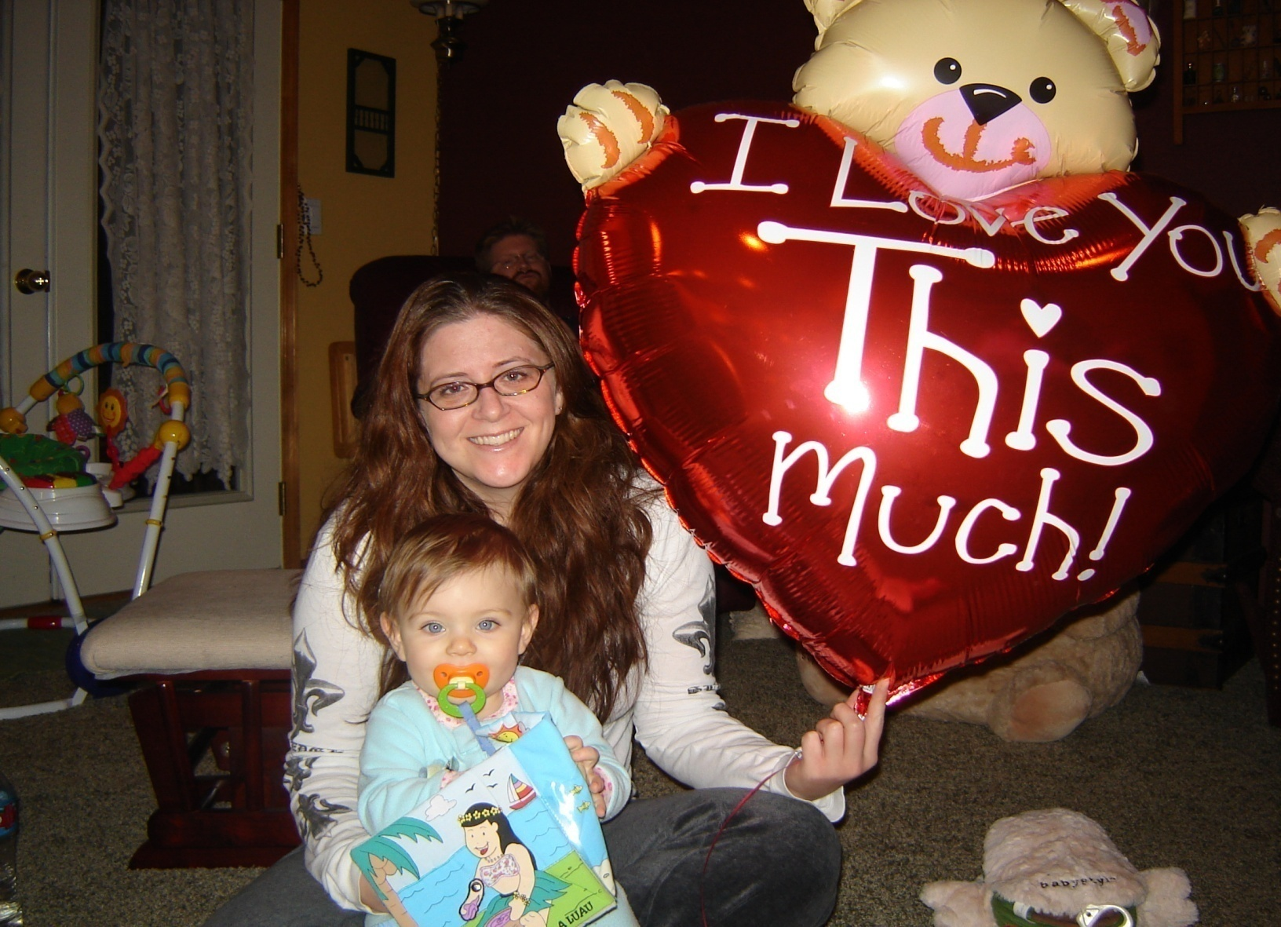
Элла и тетушка хизер

Slide 15
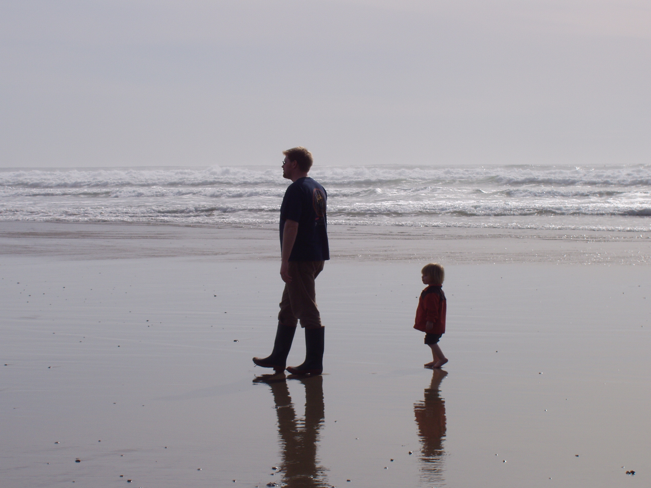

Slide 16
Чтобы назначить исполнителя завещания (личного представителя)
Чтобы назначить опекуна
Чтобы не забыть тех, кто не может иным образом жертвовать
Чтобы вспомнить о любимой благотворительности
Самые ЛУЧШИЕ основания….
Для чего нужно завещание?
Notes:
WHY HAVE A WILL?
There are several reasons to create a will. You may not be able to accomplish a number of your personal objectives if you do not have a will. For example, with a will you can choose your own executor or personal representative. I know that each of you would prefer to have someone you know and trust handle your personal affairs rather than some individual appointed by the court who may administer a hundred estates and yours is simply one of that group.
Second, you can nominate a guardian for any minor children or dependents. This is a very personal decision and is an essential reason for all parents of young children to have wills.
Third, you're able to remember persons who would not benefit otherwise. If you have no will, then the state statutes which vary from state to state (many people die in a state other than in the state where they are currently residing) will decide who receives the property and how much they receive. You may have a friend or distant relative whom you would like to benefit who will receive nothing under the statutes of the state in which you would die.
Finally, charities will receive nothing if they are not remembered in a will. I know of a case in which a friend was a supporter of a charity all of his life and would, as a bachelor, let other close family and friends know that he planned to leave his estate to charity. Unfortunately, no will was ever found and the estate went to a number of distant relatives. This person could have benefited his favorite charity if he would have just taken the time to complete a will.

Slide 18
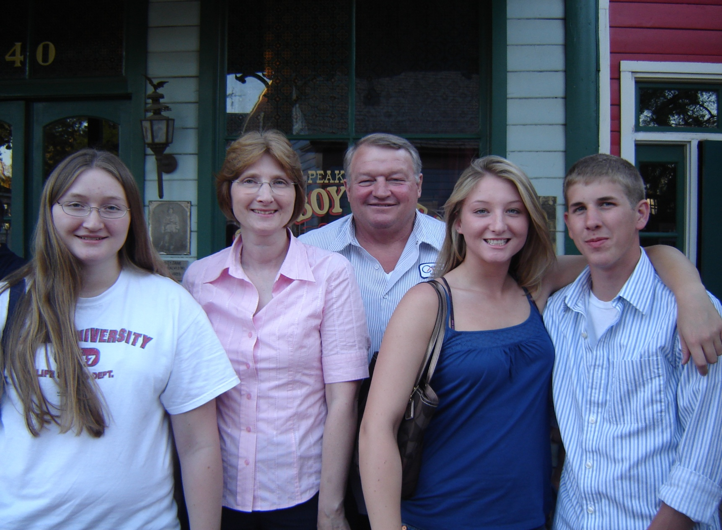
С Е М Ь Я

Slide 19
Завещатель – не оставивший завещание
Минусы
Может быть ДОРОГО
ЗАКОН определяет распределение
СУД назначает опекуна
СУД назначает исполнителя завещания
СУД определяет особые нужды
НЕТ ассигнования на благотворительность
Notes:
INTESTATE - NO WILL
If you do not have a will, you are at the mercy of the state in which you are living at the time of your death. Those states all have laws, many of them quite different, that will determine the distribution of your estate. If you are living in one state and have always had permanent residence in another state, there can be an expensive and costly litigation among the heirs who would take more under the statues of one state or the other state. And so, in some cases, the entire estate has been lost due to the enormous expense of this litigation as to who is going to get the most property.
Another problem is that the court will select a guardian for the minor children. The court may appoint someone that is totally unacceptable to you. Likewise, the court selects an administrator and determines any special needs. This court judge may not even know that person or how well he or she will understand your desires and your loved ones' needs.
Finally, there is no provision made for any of the charities that you have supported during life.

Slide 20
Действительное завещание –
требования
Совершеннолетие или требуемый статус
Способность - “Период вменяемости”
Намерение – передача собственности
Отсутствие мошенничества, недолжного влияния, давления, принуждения
Надлежащее исполнение – подпись, свидетели
Notes:
VALID WILL
When you sign a will it is most important that you follow a few basic requirements to make sure it is a valid will. Every year there are many wills that are submitted to probate courts across the land and are discarded as invalid because of some technical problem with the document or the manner in which the document was signed.
While there may be some differences in the various states, there are basic requirements for a will. First of all, the person needs to be of legal age, usually age 18, to have a will. Second, they must have full capacity to make a will. This means that they must understand that this document is a will and understand the general nature of the property and the provisions in the will that will distribute the property. You certainly don't have to be a tax attorney or a lawyer, but you need to at least have "a lucid interval" that shows that you had the capacity to understand the basics of the document.
Third, you must have the required intent. The will is intended to take effect at death and will transfer your property. You must know that it is a will that you are signing and not a baseball card autograph or some other document.
Fourth, there must be freedom from fraud, undue influence, mistake, duress or coercion. These characteristics are designed to protect the person signing the will and emphasize that the will must be his or her personal intent, not the intent of any other party, especially a beneficiary of the will.
Finally, there must be a proper signing ceremony. In most states, the proper method is for the testator to sign the will in the presence of the witnesses and then for the required 2 or 3 witnesses to sign in the presence of the testator. Usually only one copy of the will is actually signed and this copy is then retained in a safe place. However, unsigned copies of the will are typically retained by the attorney and, sometimes, other advisors to the testator.

Slide 21
Завещатель – оставивший завещание
ВЫ определяете распределение
ВЫ назначаете опекуна
ВЫ назначаете исполнителя завещания
ВЫ можете создать трасты
ВЫ можете жертвовать на благотворительность
Notes:
TESTATE - WITH A WILL
There are many advantages for people who do have a will. First, you specify the distribution. You can give any amounts or percentages to the persons that you pick rather than depending on the state statute to allocate or distribute in a manner that you might find totally unacceptable.
Second, you nominate the guardian. If you have minor children, I'm sure you would far prefer to pick for yourself the most important person who will be entrusted with the care and upbringing of those loved ones, rather than have the state judge, who knows nothing about you or your family or your desires, select someone to be the guardian.
Third, you choose the executor, a personal representative. He or she has a great deal of power and authority. He or she will be in charge of managing the estate, paying all the bills, and making the final distributions under your plan. You want to make sure you have selected someone who will do a good job and see that the plan is properly carried out.
Fourth, you can create trusts. There are many reasons to create trusts. Some family members would be far better to receive distributions of income rather than a lump sum principal amount. You can make provisions for these family members in a way that is most helpful to them in a trust.
Finally, you can make transfers to charity. The gifts to charity could serve as a legacy or remembrance to your involvement and support of those charities during your lifetime.

Slide 22
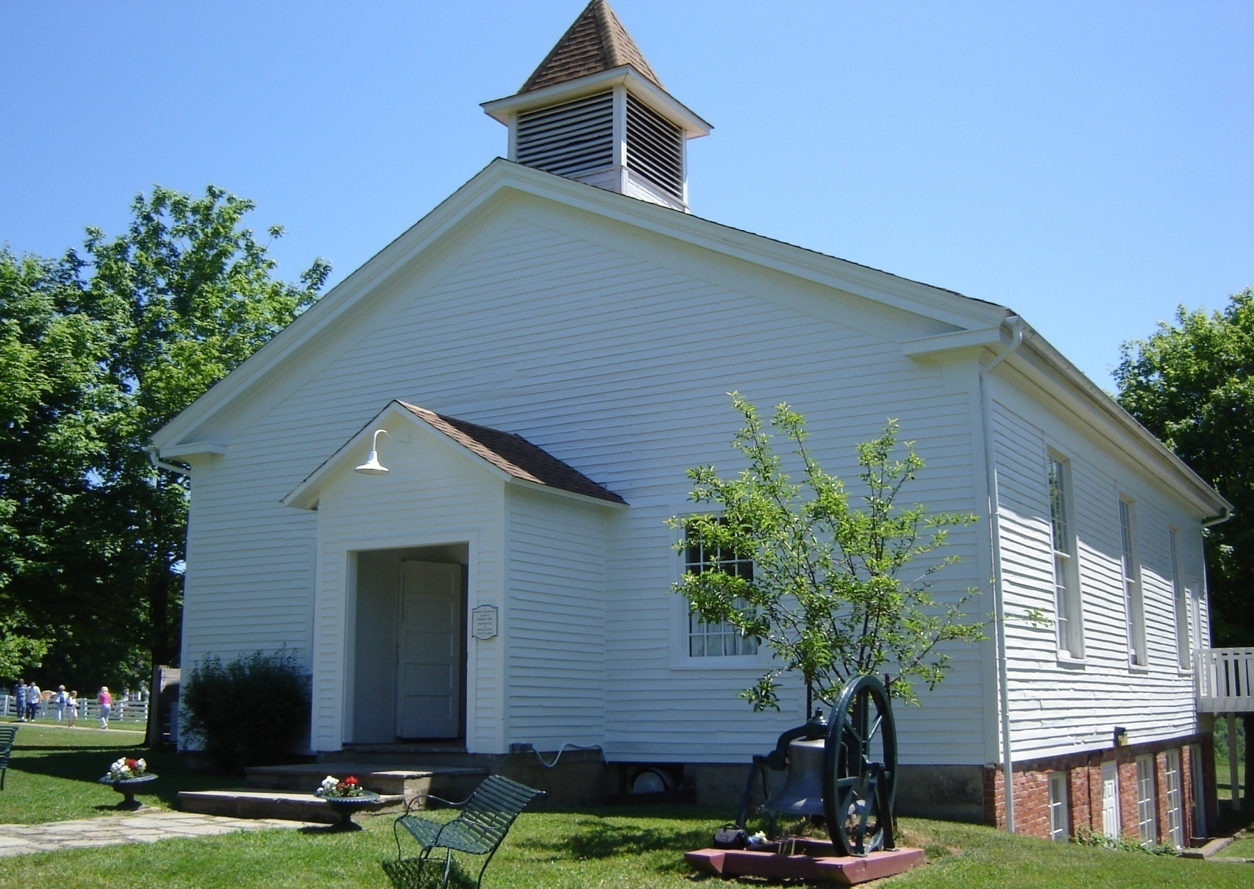
ВОЗМОЖНОСТИ БЛАГОТВОРИТЕЛЬНОСТИ

Slide 23
Почему мы не составляем завещания
Очень заняты
Очень мало имущества
Слишком дорого
Юридические документы
Неизвестность будущего
Не планирую умирать
☺☺☺
Notes:
REASONS WE DON'T MAKE WILLS
If we were to visit with people that don't have wills, perhaps we would hear these statements. Person number 1 is too busy with life. He has many irons in the fire. As he goes from work, to home, to meeting, he just doesn't have time to get one done.
Person number 2 says they have too little property. They aren't worth large amounts of money and they don't feel they need a will with their amounts of property. Of course, what they perceive as too little property may actually turn out to be quite a bit of value by the time they pass away. There are a number of cases of people who had fairly modest means or investments, but during their latter years their investments significantly increased in value and they passed away with no will and large property.
Person number 3 thinks it's too expensive. While it is true that a will can cost $200, $300 even $500 or more, the expense of the will must be compared with the expense of not having a will. There are a number of people who did not have wills and their estates went into probate. By the time the cousins and relatives and attorneys and everyone else fought over the estate for several years, the will that they eventually ended up with by court decree cost them $10's of thousands and even millions of dollars.
Number 4 - They don't like legal documents. I can understand people not liking legal documents. They're sometimes hard to read and sort out. I encourage people to see that their lawyer gives them a good explanation or, in some cases, a short summary of what it is that this document does for them. You need to be sure that you understand the legal documents that are going to make substantial provision for all of your family and friends.
Number 5 - Person number 5 says they're unable to know the future. Well, I do have one bit of news for person number 5. In this country several millions of people who don't know the future have faced one certainty and that was that they would die and pass away. When they died they left their property behind. Some left property behind in good situations; some left property behind and created colossal problems for their family and friends.
I don't plan to die. Person number 6 simply plans to go on and on. He takes his vitamins, gets that morning walk, and has that post card in his drawer addressed to Willard Scott for his 100th birthday. He just plans to keep on going.
Well, folks, at some point this is something that is going to happen to all of us. In the history of the world, it has been noted with regularity that people do pass away. The fact that you do or don't have a will doesn't seem to have much of an impact on whether you do pass away. If anything, the indications are that those who have good plans have greater peace of mind and, if anything, live longer.

Slide 24
11 вещей, которые нужно запомнить
Составляйте завещание и стройте планы
Регулярно дополняйте ваши планы
Проконсультируйтесь с юристом
Предусмотрите одну альтернативу
Назначьте конечного получателя
Заплатите другим
Старайтесь составлять сбалансированные планы
Не забудьте о других активах
Будьте гибкими
Говорите о ваших планах
Используйте правильное официальное название

Slide 25
11 вещей, которые нужно запомнить
Составляйте завещание и стройте планы
  За исключением, если у вас уже есть законное завещание или другие соглашения, то другие могут решить за вас….
  Сюда могут входить и другие планы;
    Ежегодная рента с пожертвований на благотворительные цели
    Благотворительный остаточный траст
    Траст ежегодной ренты остатка недвижимости даруемого в благотворительных целях
    Траст с ведущей благотворительной целью
    Консультируемый фонд
    Дарения страхования жизни
    Дарения активов плана пенсионного обеспечения
    Сохранение пожизненного права на недвижимое имущество
Notes:
консультируемый [информируемый] (дарителем) фонд (разновидность фонда, отличающаяся тем, что даритель или другое лицо, вкладывающее средства в фонд, может давать рекомендации или сообщать свои пожелания относительно тех целей или тех бенефициаров, которым данные средства могут быть переведены; однако руководство такого фонда формально не обязано следовать этим рекомендациям и может в некоторой степени отклоняться от пожеланий дарителей)

Slide 26
ВАШИ ПЛАНЫ НА БУДУЩЕЕ
Составляю ли я завещание. Строю ли я планы в этом служении?
  Кто вы бы хотели, чтобы сделал набросок вашего завещания илисоставил за вас планы?
    Сосед
      Члены семьи
        Государство
          Кто должен управлять вашими делами?

Slide 27
НЕТ ПЛАНОВ – ЧТО ДАЛЬШЕ
Правильно ли будет если согласно законам вашей страны, вся ваша собственность автоматически в равной степени перейдет вашим самым близким родственникам, несмотря на ваши пожелания?!
Вы еще уверены, что ваши планы, все еще соответствуют вашим потребностям?
  Соответствие вашего завещания (самоуправляемый траст) и других планов современным требованиям, может быть так же важно, как и их первоначальная подготовка.

Slide 28
НЕТ ПЛАНОВ – продолжение
  Соответствие вашего завещания и других планов современным требованиям может быть так же важно как и их первоначальная подготовка. ☺
С другой стороны ОТСУТСТВИЕ ПЛАНА – это план, просто но не такой воодушевляющий и удовлетворяющий ☹
Возможно вы никогда не измените свои планы.
Если только в вашей жизни не произойдут некоторые из самых распространенных событий!

Slide 29
Те, кому нравится все что у них есть - счастливее, чем те, которые пытаются иметь все, что им нравится.

Slide 30
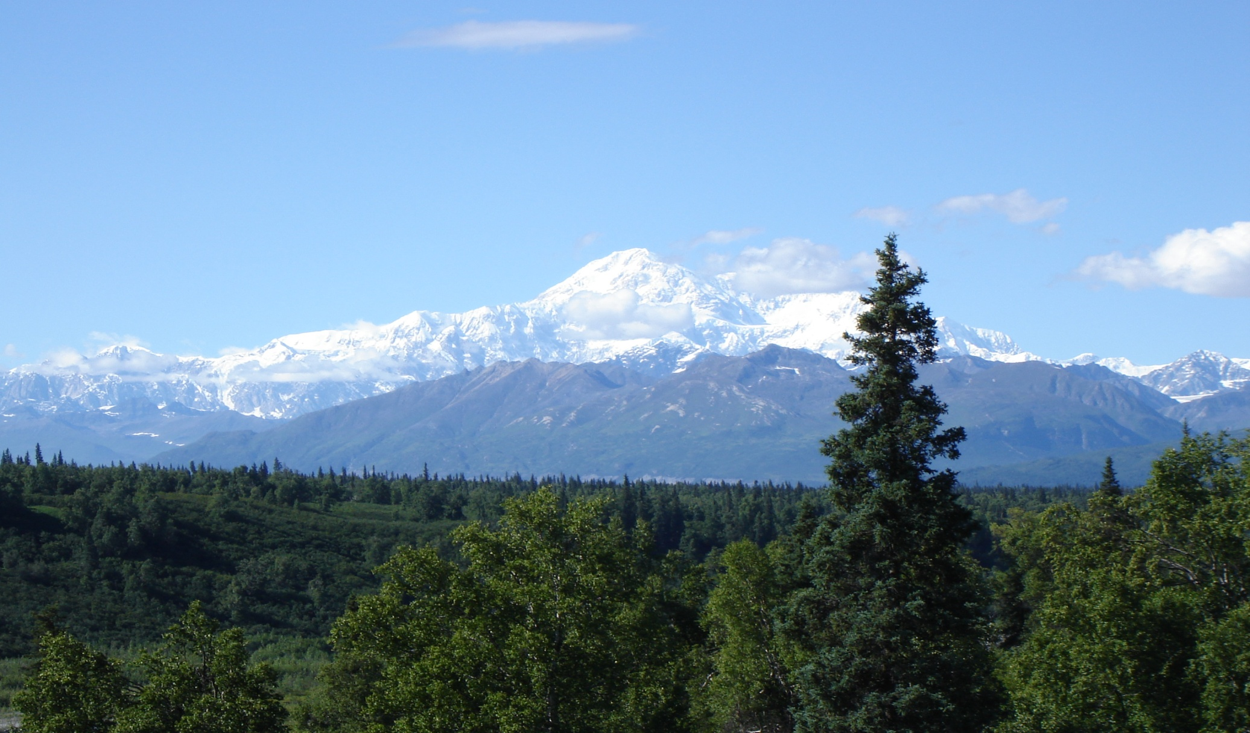
ВОПРОСЫ И ДОГОВОРЕННОСТИ?

