Slide 1
Planned Giving &Trust Service Report Euro-Africa Division
2005 - 2010

Slide 2
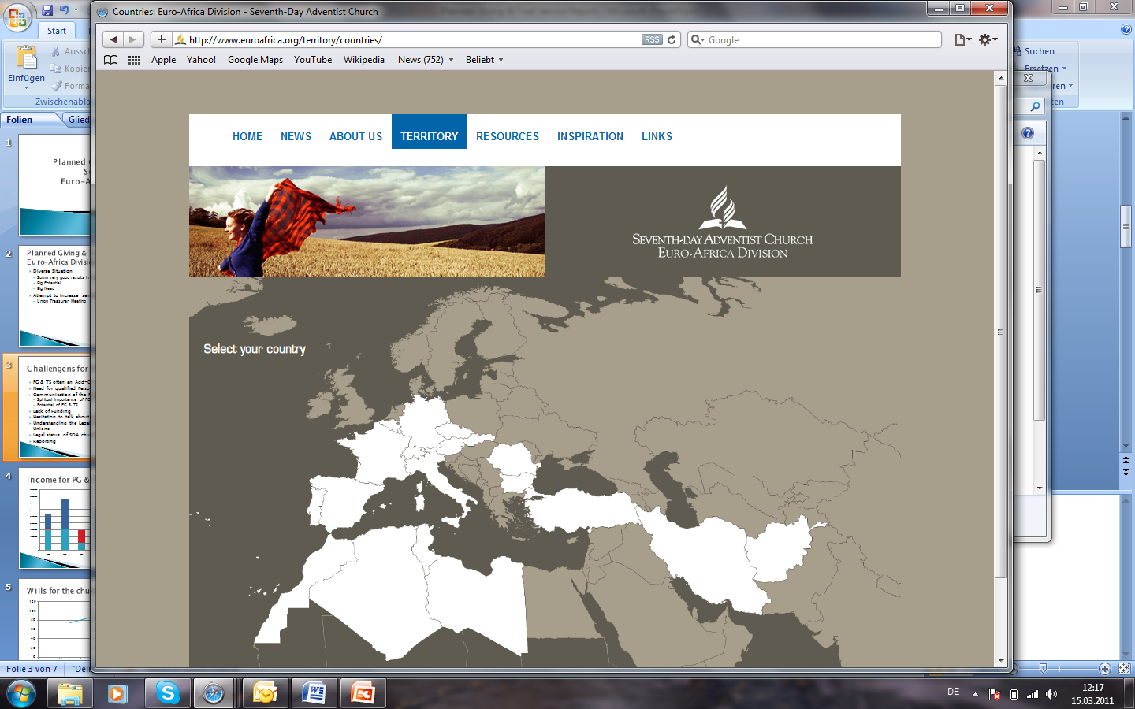
Notes:
27 countries, 22 languages

Slide 4
Planned Giving & Trust Services in Euro-Africa Division
Diverse Situation
Some good results in some Unions
Big Potential
Big Need
Attempt to increase sensitivity to PG & TS
Union Treasurer Meeting

Slide 5
Challengens for PG & TS
PG & TS often an Add-On for the Treasurer
Need for qualified Person on Union Levels
Communication of the Potential for PG & TS
Spiritual importance of PG & TS
Potential of PG & TS
Lack of Funding
Hesitation to talk about money
Understanding the Legal Environment in the Unions
Legal status of SDA church in some fields
Reporting

Slide 6
Income for PG & TS 2006-2010
Notes:
Figures are taken from reports to GC, Not complete for 2010 (Austrian Union missing), some Unions seem to not understand what that is

Slide 7
Wills for the church

Slide 8
Key-Factors for PG & TS
Relationship of Trust
Trust in the Person doing PG & TS
Trust in the Organization
Spiritual Responsibility
Committment
Personal Involvement
Love for People
Communication
Competence

Slide 9
Strategic Plan for 2011 - 2015
Goal: Implementing a formally organized PG & TS Department in most of our Unions
Preparing the Environment
Development of a PG & TS Concept on Union Level
Meeting with Union Treasurers (Sep. 19-22, 2011)
Committment of the Administration on Union Levels
Communication to Membership
Studying legal Environment
Definition and Communication PG & TS Concept on Union levels
Plan for Funding of PG & TS Director on Union Level
Providing Training and Support
Evaluation

